Slide 1
STATISTICS &NUMERICAL METHODS MINI PROJECT
BY Name
Reg no
Branch,sec

Slide 2
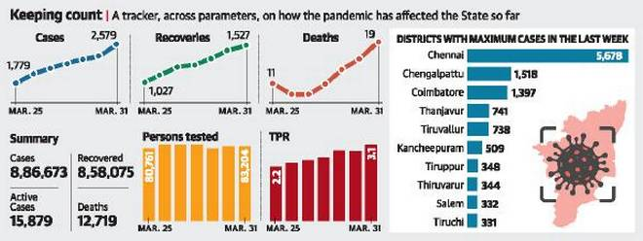
COVID-19 DATA ANALYSIS OF DISTRICT WISE

Slide 3
DETAILS of COVID 1st WAVE
CASES:2,579
RECOVERED:1527
DEATH:19

Slide 4
SIMPLE RANDOM SAMPLING
The 10 samplings are :
123456
234579
546378
345267
987534
145890
325671
667890
468093
135790

Slide 5
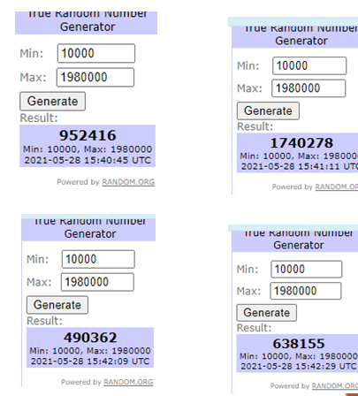
RANDOM SAMPLING AFTER GENERATING

Slide 6
***THANK YOU***

